Slide 1
Trajectory and Environment Modeling for Human Robot Collaboration Predictive Collision Detection
A Thesis Presented to The Faculty of the MAE Within the HWCOE, University of Florida
Gabriel Streitmatter
Under the advisement of Faculty Member
Dr. Gloria Wiens
April 17, 2020

Slide 2

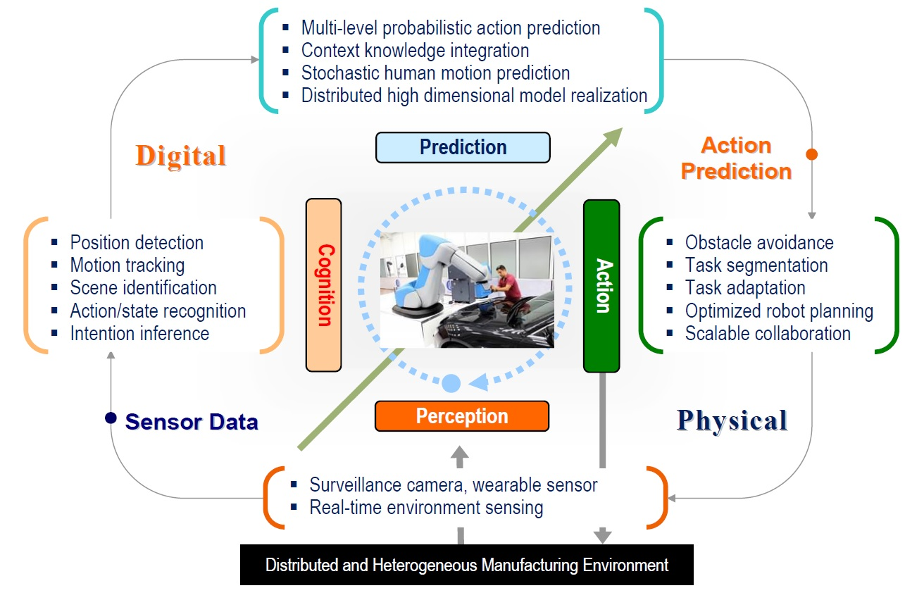
Motivation - Scope of collaborative effort
1) Perception:
Object detection, tracking and recognition
Many-to-one collaborative sensing
Combination of passive and active sensing
Implementation of local and global sensing
2) Cognition:
An adaptation architecture to customize initial cognition models and understand human actions within different manufacturing cells
3) Prediction:
Integrated distributed particle filters with human motion models
Tracks and predicts human motion trajectory with probabilistic uncertainty evaluation
4) Action:
Multilayer, modular control structures
Stable mode switching for flexibility in defining the ‘optimized’ robot response to a disturbance
Adaptability to unplanned interactions and disturbances within the workspace
Graduate researcher: Gabriel Streitmatter
Notes:
This work is in contribution to a collaborative effort to develop better methodologies for human robot collaboration (HRC) in manufacturing. There are many benefits to human robot collaboration in that it is able to combine the strengths of humans and robots by putting them into collaborative teams. This allows for flexible yet highly precise and productive manufacturing techniques. There are many challenges that surface when implementing HRC, however. Ability for the robot to sense and react to dynamic environments, and safety of the humans are some of the chief challenges.
To address these challenges, the work has been subdivided into four main research tasks that are: Perception (reliable obstacle detection and many-to-one collaborative sensing), Cognition (understand human action inside the workcell), Prediction (predict human motion with probabilistic uncertainty evaluation) and Action, which is the focus of research here at the univ of FL:
Multilayer, modular control structures
Stable mode switching for flexibility in defining the ‘optimized’ robot response to a disturbance
Adaptability to unplanned interactions and disturbances within the workspace
The goal of this work is to contribute to the robot the ability to look ahead at its trajectory and the predicted trajectories of other entities in its environment and predict any future collisions.
This contribution is in the form of an algorithm that will function in tandem with other robot control algorithms designed for effective HRC.

Slide 3
Introduction
The algorithm developed in this work is a predictive collision detection algorithm
Common approaches to predictive collision detection:
Multiple Interference Detection: Computationally quick but highly prone to missing collisions
Swept Volume Interference: Computational expensive but much more robust in that it provides continuous collision detection
The goal of this algorithm is to use concepts from both approaches to strike a tradeoff, and provide a solution that is both robust and quick
Notes:
The algorithm developed in this work is a predictive collision detection algorithm
Common approaches to predictive collision detection:
Multiple Interference Detection: Computationally quick but highly prone to missing collisions
- This approach involves selecting a representative set of configurations (poses) throughout the robot’s trajectory at which to check for interference.
- While this method is generally much faster than most other methods, it runs the risk of missing a collision due to an insufficient number of interference checks
Swept Volume Interference: Computational expensive but much more robust in that it provides continuous collision detection
- In this method, a volume is generated by sweeping an object along a trajectory and including in the volume all points occupied by the object at any given time.
- This can be done for multiple objects. If the volumes generated by any objects intersect and the times at which the objects pass through the intersection points in the volumes match, then a collision has been identified
- This approach does not risk missing collisions as the Multiple Interference Detection approach does, but tends to be incredibly computationally expensive
The goal of this algorithm is to use concepts from both approaches to strike a tradeoff, and provide a solution that is both robust and quick

Slide 4
Overview of the Approach
Create a common discretized workspace described in X Y Z coordinates
Determine the location of points along the boundary of the robot and human
Iterate this process for various instances in time
Interpolate continuous position throughout time by leveraging Coons patches
Apply initial and final boundary orientations
Convert all computed swept volumes to a standard coordinate system
Directly compare all volumes for spatiotemporal intersection
Notes:
Create a common discretized workspace described in X Y Z coordinates. This is a crucial initial step. As will be seen later, this step is crucial in the quick comparison between all volumes generated. Additionally, parameters used in the modeling of the human and robot depend on the grid spacing.
Determine the location of points along the boundary of the robot and human.
- assumed information about the joints of the human and robot
Forward kinematics used specify in a fixed coordinate frame the location of various key joints that will be used to define the outer boundary of the human and robot
Safety factors for the algorithm, which will be discussed in more detail later, will also be included in this step
Iterate this process for various instances in time
Describe the physical location of these points on the human and robot boundary at multiple snapshots in time throughout the scheduled or predicted trajectory
Interpolate continuous position throughout time by leveraging Coons patches
Use Coons patches to patch together these instantaneous poses in time
The points found in the forward kinematics steps are used ass corners for these patches.
This defines a point cloud where each specified point also has time data indicating the time at which the point is occupied.
Apply initial and final boundary orientations
To close the surface generated by sweeping the boundary curves, these boundary conditions are defined using points in the first and last pose from the input data
Convert all computed swept volumes to a standard coordinate system for direct comparison
This standard coordinate system is the same one defined in the first step
A standardized discrete time array is also adopted to fit the time for each point to
By fitting the volumes to a standard coordinate system, the volumes can be directly compared
Directly compare all volumes for spatiotemporal intersection
- Thanks to the standard coordinate system, collisions occur at all locations in which the X, Y, Z and time values exactly match

Slide 5
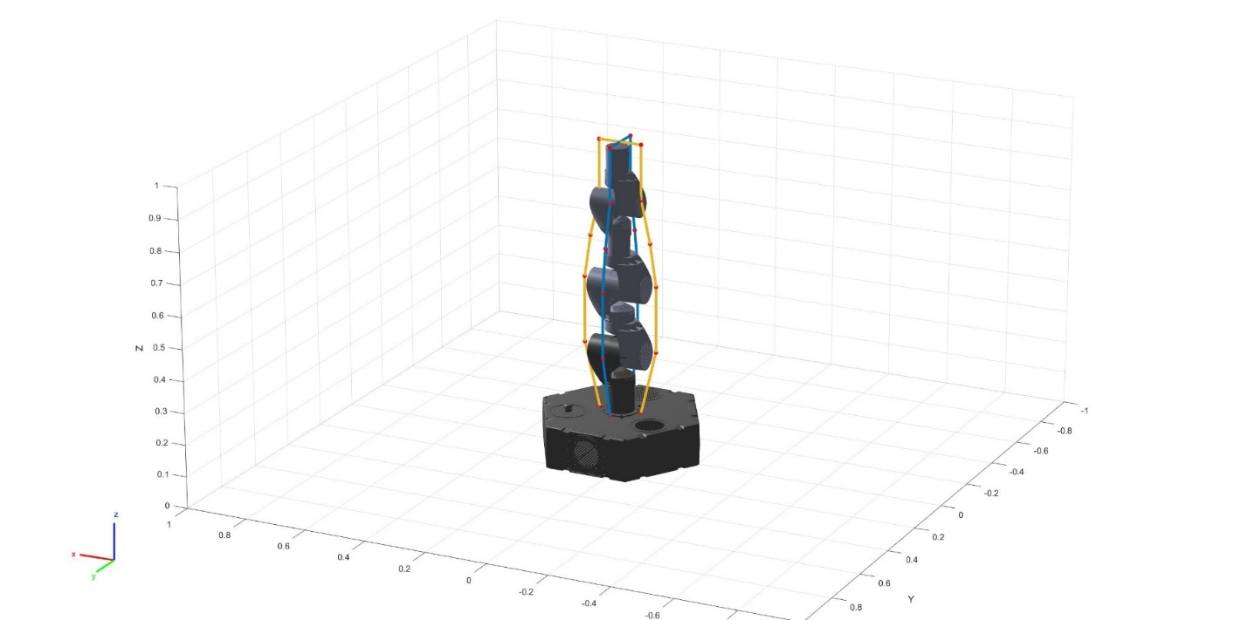
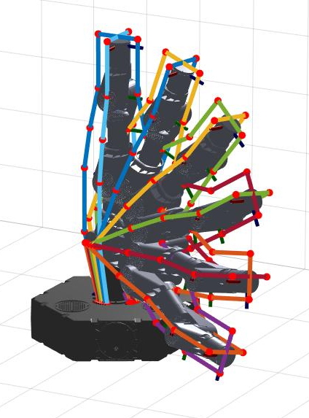
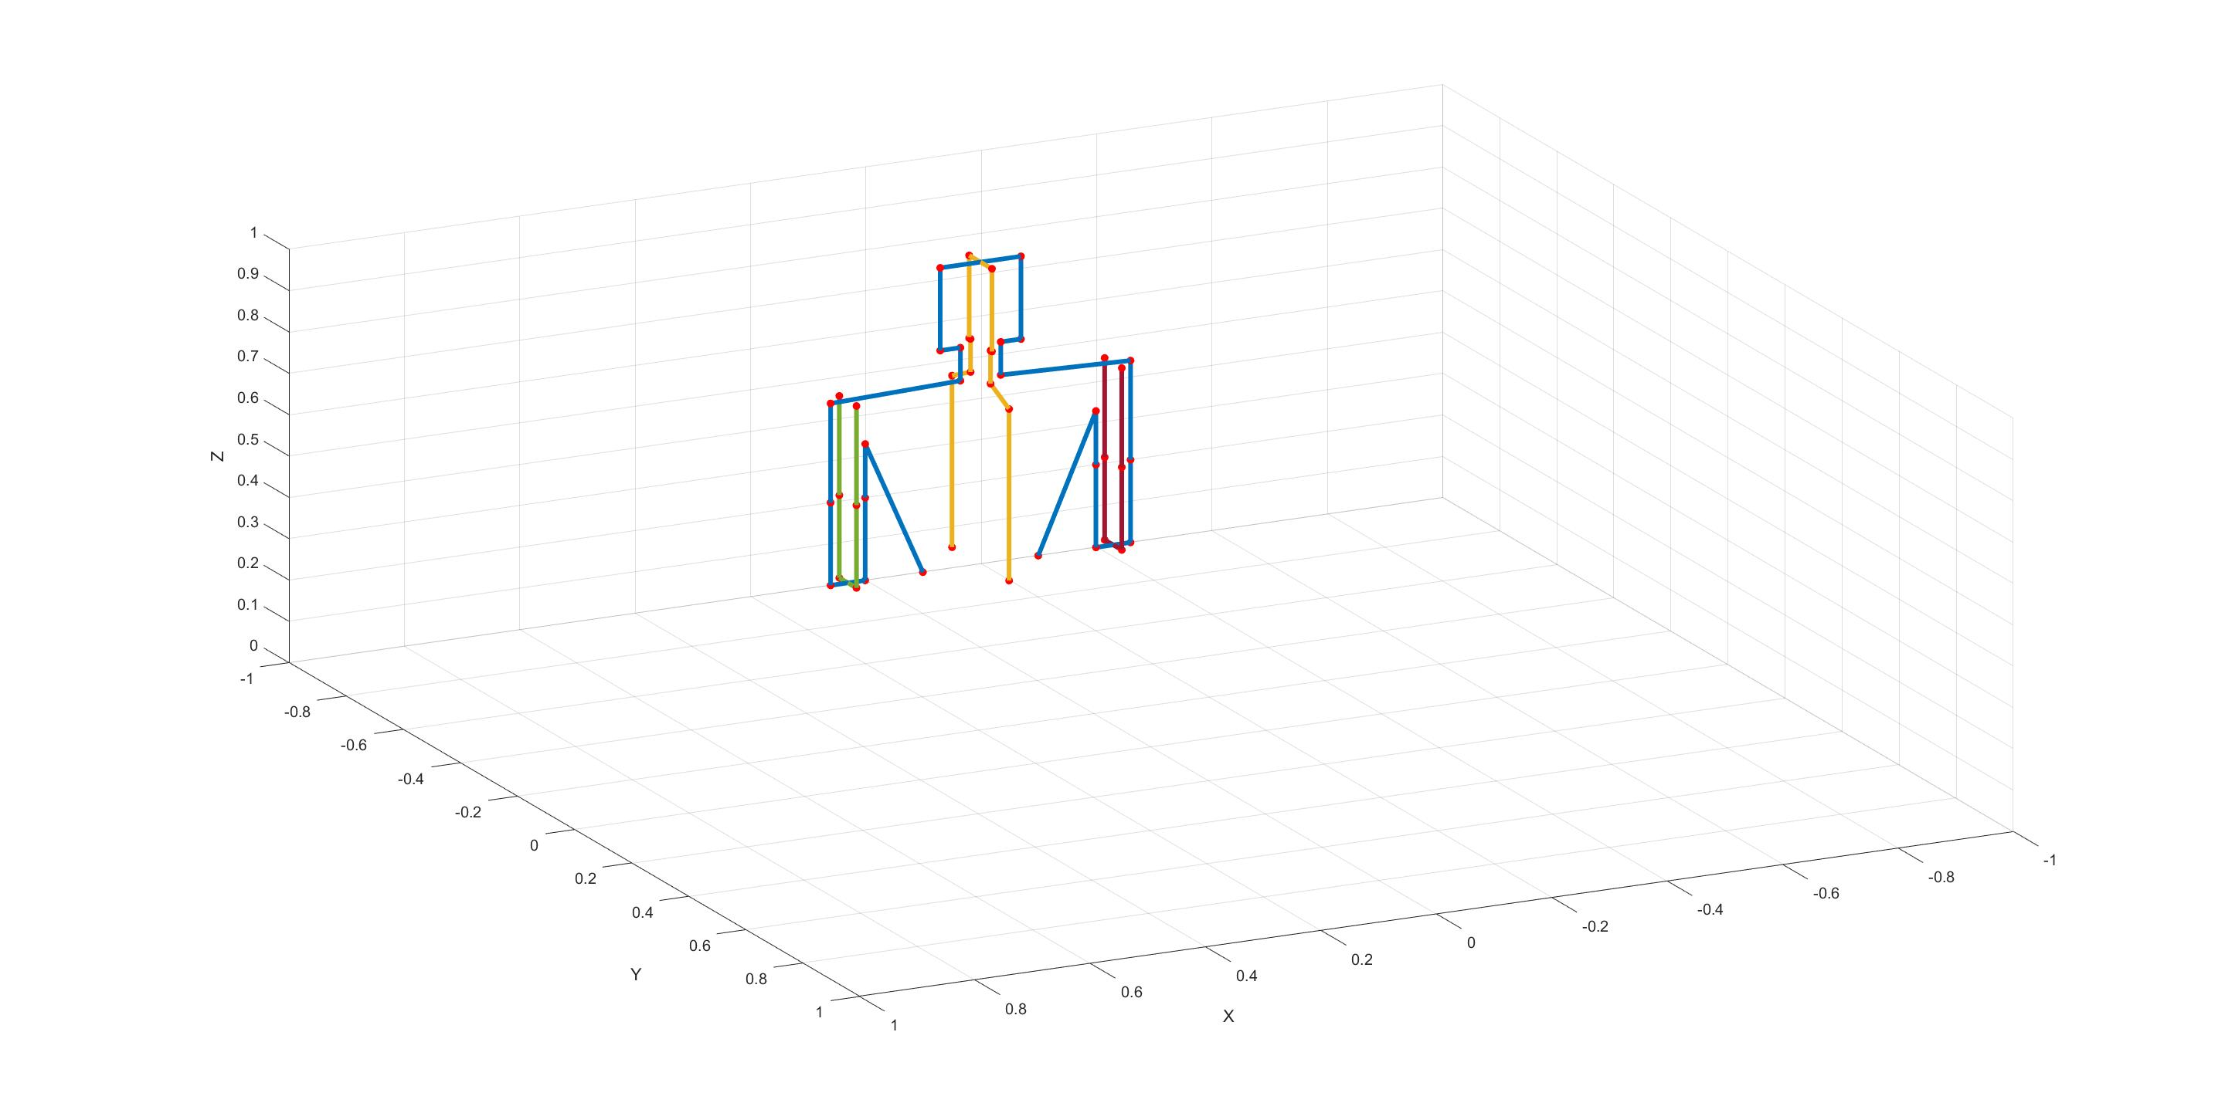
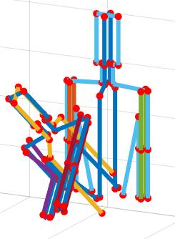
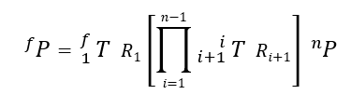
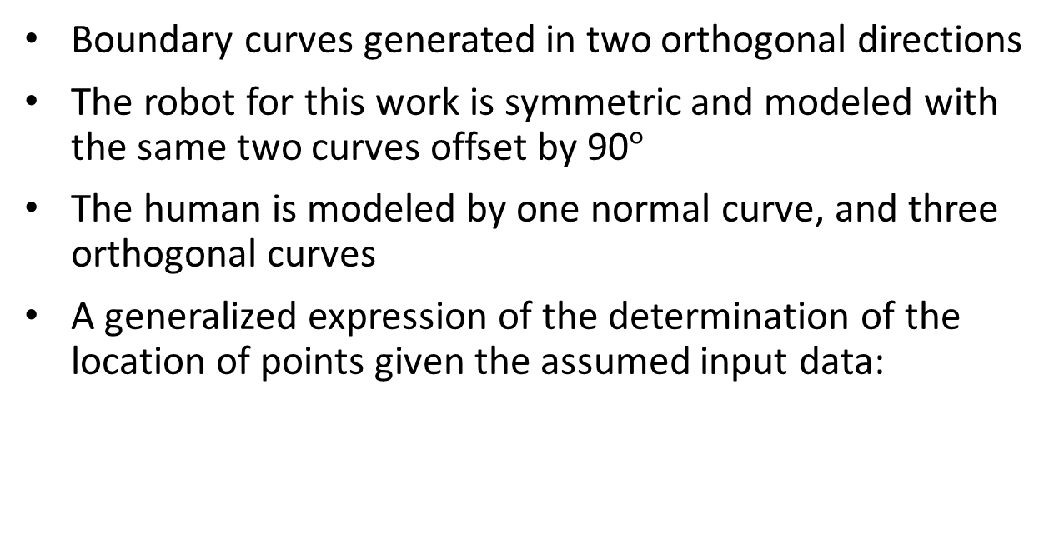
Definition of the Boundary Curves with Forward Kinematics
Boundary curves generated in two orthogonal directions
The robot for this work is symmetric and modeled with the same two curves offset by 90$°$
The human is modeled by one normal curve, and three orthogonal curves
A generalized expression of the determination of the location of points given the assumed input data:
Notes:
Boundary curves generated in two orthogonal directions
At this point boundary curves are just described as a series of points defined along the modeled object’s boundary. When the Coons patches are implemented, more points between these boundary points will be defined to describe the curve in a discrete manner.
The two curves are referred to as the normal and orthogonal curves
Both curves are required. If only one is used and the modeled object moves in a direction in plane with the curve, then the generated volume will lie entirely in one plane.
By using both curves, no matter the direction of motion, the outer edges of the object will be modeled
The robot for this work is symmetric and modeled with the same two curves offset by 90$°$
The human is modeled by one normal curve, and three orthogonal curves
Two curves for the arms
One for the head neck and torso
Orthogonal curves are added wherever the possibility of motion in a direction not bounded by a previously defined curve can occur
A generalized expression of the determination of the location of points given the assumed input data:
Coordinate systems at each joint are defined. These coordinate systems and related calculations will be described in more detail in subsequent slide
The origin of the coordinate system is located at the center of the joint. Boundary points near each joint are defined and their location within the closest joint’s coordinate system is known
To find the location of the point in the fixed coordinate system after an arbitrary rotation of the closest joints and all joints preceding it in the kinematic chain, transformation and rotation matrices are used.
The location of point P in coordinate system n can be translated to the fixed coordinate system my premultuplying by a series of transformation and rotation matricies.

Slide 6
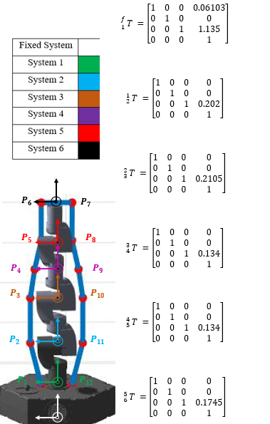

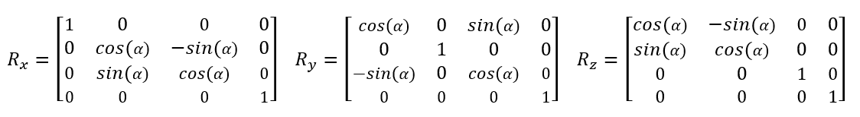
Robot Model
Coordinate systems defined at each joint
Boundary points defined in each system
Relation between each coordinate system and the prior system is described by a transformation matrix
Each point found in such way is tracked throughout each pose in the assumed input information.
Due to symmetry of the robot, the orthogonal curve us the same is the normal curve only defined in the Y-Z plane
Notes:
Coordinate systems defined at each joint
- Each system shown is a revolute joint
- As seen in the figure the X axis is to the left, Y is out of the page and Z is upward. The origin is along the centerline of the robot
- Systems 1, 4, and 6 rotate about their Z axes
- Systems 2,3, and 5 rotate about their X axes
Boundary points defined in each system
As shown in the figure, the boundary points used to describe the robot are color coded to match a system
The location of these points is known with respect to the corresponding system and is expressed in homogenous coordinates [x y z 1] so that the array would be compatible with the forward kinematics techniques used.
- This is done because as all joints undergo arbitrary rotation, only the point’s location in the system it rotates with will remain known
Relation between each coordinate system and the prior system is described by a transformation matrix
After arbitrary rotation, it is necessary to translate the known position of each point within its own coordinate system to the fixed coordinate system
Since the joint angles are assumed to be known, and the linkage geometry constant, this can be done by premultiplyig the point by the preceding transformation matricies along with rotation matrices to account for rotation of each prior joint
It is a trivial extension to adapt this approach to various other types of joints (ball joints, prismatic, cylindric, ect.) by placing variables in the transformation matrices, but since the robot we have for testing uses only revolute joints, this is what I developed the algorithm for.
Each point found in such way is tracked throughout each pose in the assumed input information.
So far only the points throughout time are being tracked, actual curves are not being created between the points yet.
The curves will be generated in the next step. These serve as the boundary points of the curves
By selecting points the wrap the entire robot, the sweep of this curve as the robot moves envelops the robots position throughout its trajectory
Due to symmetry of the robot, the orthogonal curve us the same as the normal curve only defined in the Y-Z plane
- The normal curve was defined entirely in the XZ plane and the orthogonal curve entirely in the Y-Z plane
- As shown in the figure, this is the assumed home position of the robot. Arbitrary starting and ending joint angles can be supplied, but they are supplied with respect to this orientation

Slide 7
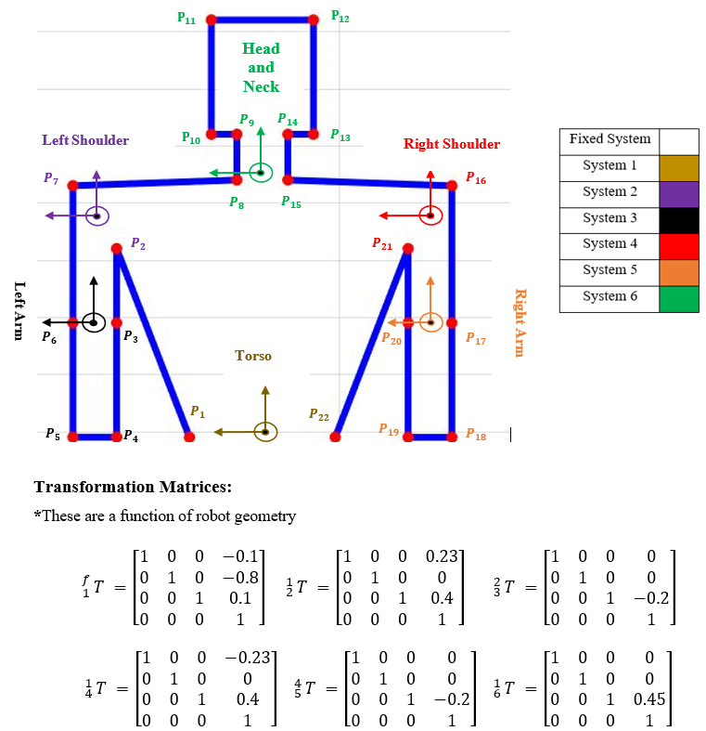

Human Model
Coordinate systems are modeled at each joint that is free to rotate
A seated worker engaged in a tabletop activity is modeled to interface with the robot
The same forwarded kinematic technique is used
As done with the robot, these boundary points are located for each known pose of the human
The orthogonal curve is more complicated for the human than the robot, and requires further development
Notes:
Coordinate systems modeled at each joint that is free to rotate.
Systems 1-6 represent the Torso, Left shoulder, Left Elbow, Right shoulder, Right Elbow, and Head and Neck respectively
The torso, neck, left shoulder, and right shoulder are modeled as ball joints and are free to rotate about their respective X, Y, and Z axes
The Left and Right shoulders are modeled as revolute joints, and constrained to rotate only about their X axes
A seated worker engaged in a tabletop activity is modeled to interface with the robot
- Because the robot selected to interface with the human is a tabletop low payload pick and place robot, the human was modeled to stand near the robot and interact
Since the human is assumed to stand at the same location at a collaborative worktable, only the upper portion of the human was modeled. This was done to maximize computational time while still modeling a meaningful HRC interaction
The same rotation matrices as used on the robot model are used here,
The same rotation matrices as used in the robot model are used here
Translation matrices are defined to translate the position of the indicated points defining the boundary of the human from their joint’s system to a fixed system
The fixed system here is the same as the fixed system used in the robot model

Slide 8
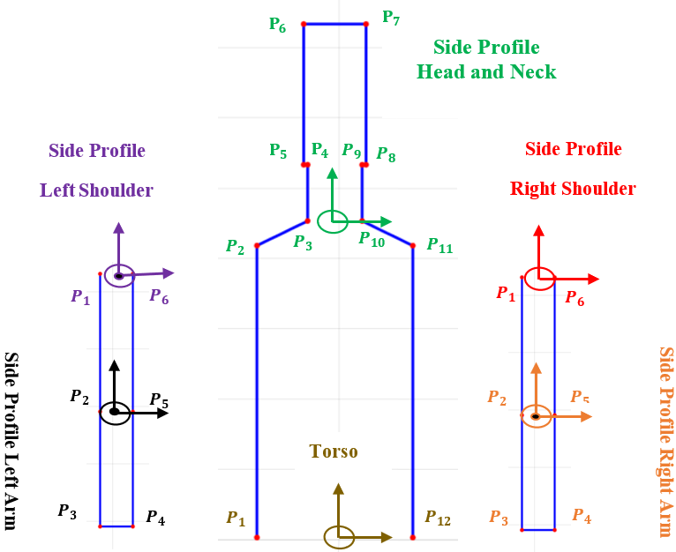
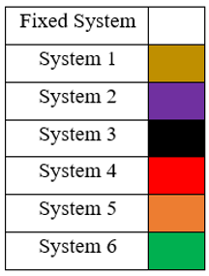
Human Model Orthogonal Curves
These curves are used to describe the side profile of the human
The orthogonal component is necessary to capture the full profile of the human
The same coordinate systems defined for the normal curves can be reused
The same forwarded kinematic technique is used
These points are tracked throughout time along with the points on the normal curve
Notes:
These curves are used to describe the side profile of the human
- Since the two arms and the torso can each move independently in the multiple axes of motion, it is necessary to define an orthogonal component of the profile for them all
To maximize on computational efficiency, rather than use 1 continuously connected curve, three separate curves are used: The left arm, the right arm, and the head neck and torso
The orthogonal component is necessary to capture the full profile of the human
This is most clearly understood by considering if only the normal component was used. In this case if any of the joints were to rotate about their Y axis the result would be an entirely planar surface.
Adding side profiles captures the full volume of the moving human such that the motion in any direction will have some component in the normal and some component in the orthogonal direction
By sweeping both curves, and overlaying the resultant surfaces, the outermost surface represents the true volume swept out by the human.
The same coordinate systems defined for the normal curves can be reused
As seen in the figure, the Z axis is upward, the Y axis is to the right and the X axis is coming out of the page
The same transformation and rotation matrices can also be used along with the same assumed input joint data

Slide 9
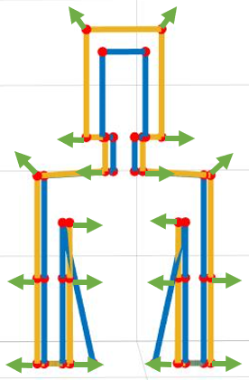
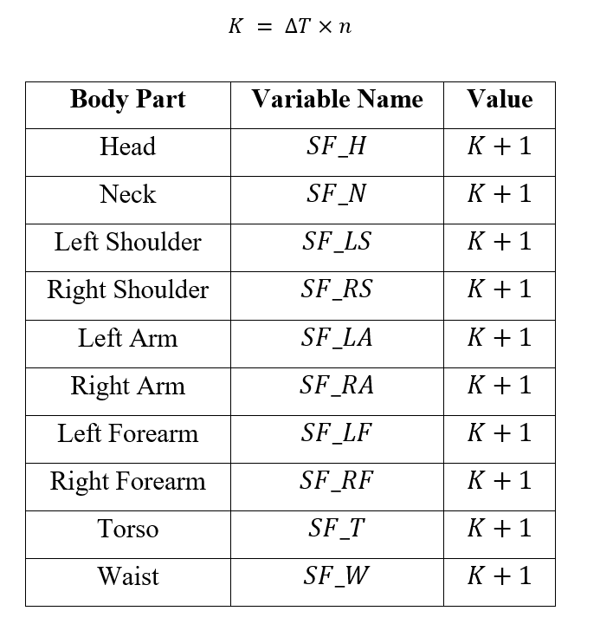

Safety Factors
Safety factors built into definition of the boundary points
Safety factors defined to grow with time at a specified rate for each body part
Scaling factors added to strategic position of boundary points to enlarge the human boundary in a meaningful way
Example calculation of the location of the left shoulder
Notes:
Safety factors built into definition of the boundary points
This is done for two reasons: 1) to account for uncertainty in the prediction of the human and
2) to account for human comfort levels as close calls where the robot knows there will be collisions can be unsettling and counterproductive if humans abruptly alter their motion when the robot approaches
The effect of the safety factors is to enlarge the body parts of the human by an amount equal to the product of the elapsed time between the initiation of the algorithm and the prediction and a scaling factor
Safety factors defined to grow with time at a specified rate for each body part
It should be noted that it may be the case that the head neck or torso is deemed more critical than the arms. Due to differing importance, the safety factors are designed such that different body parts can be set to expand at higher rates than others
The human is divided into 10 sections that can be weighted individually: The head, neck, left shoulder, left arm, left forearm, right shoulder, right arm, right forearm, torso and waist
While this ability was built in and can be easily updated, for the purposes of demonstrating the algorithm, all of the safety factors expand at the same rate
In the table, the safety factors are shown to start at unity, representing no expansion of the human at the first orientation
As time increases, K increases as well in proportion to n. n can be individually defined for each body part
Scaling factors added to strategic position of boundary points to enlarge the human boundary in a meaningful way
As shown in the figure, points on the arms and neck are set to increase change their position in the X direction.
While points on the shoulder and top of the head are set to expand in both the X and Z direction.
This is also done for the orthogonal curves. Expansion in this case takes place in the Y and Z directions.
For junctions between two body parts, to promote continuity of the model, the points are set to expand according to the larger safety factor
Example calculation of the location of the top left point on the head
First, the appropriate safety factor, the one corresponding to the head, is selected.
If this calculation was competed for say a point on the elbow, the safety factors of the arm and forearm would be compared and the larger one selected
Next the position of the point is scaled by the safety factor
Finally, the location of the point is translated back to the fixed frame

Slide 10
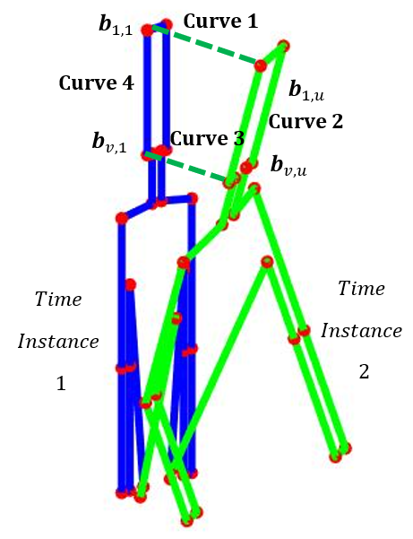
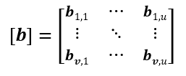
Connection of Boundary Curves
A composite surface created by patching together the boundary points from consecutive time steps.
Discrete Coons Patches are implemented to define points at a mesh size within the boundaries
The boundary points are placed in the corners of a matrix (called in this work a patch)
Patches are created to store the X, Y, Z, and time components of the modeled object’s motion
Notes:
A composite surface created by patching together the boundary points from consecutive time steps.
Surfaces are generated within the boundary points found in the forward kinematics step
A surface is generated to describe all points occupied by a specific segment of the modeled object as it moves from one orientation to the next
Iterating this process for all segments used to define the boundary between each instance in time for which the forward kinematics procedure was implemented, the overall surface can be generated in a general manner applicable to any inputted set of these boundary points.
Discrete Coons Patches are implemented to define points at a mesh size within the boundaries
Coons patches are a computer aided modeling technique for defining surfaces.
A discrete version of the Coons patch formulation is implemented here in which
An ordered mesh of points is defined to fill in data between set boundaries such that the filled in data represents an interpolation between the four boundary curves
The boundary points are placed in the corners of a matrix (called in this work a patch)
- To begin the definition of the boundaries of the discrete Coons patch to be formed, the points found in the forward kinematics step are placed into the corners of the discrete Coons Patch
The boundary curves, which will be fully defined in the next step, are defined to connect these points.
Curve 1 traces out the trajectory of one point on the modeled object as it travels between one orientation to the next.
Similarly, Curve 3 traces out the trajectory of a consecutive point on the modeled object as it travels between one orientation to the next.
Curve 4 connects the two points at the first time instance and curve 2 connects the same points at the second time instance.
This formulation is used for the X, Y, and Z dimension
Patches are created to store the X, Y, Z, and time components of the modeled object’s motion
A total of four patches are required to describe the motion, both spatially and temporally, of one segment of the modeled object between two poses
The curve definition for the time patch is a bit simpler. B11 and BV1 are both the time at which the first orientation occurs and B1U and BVU are both the time at which the second orientation occurs

Slide 11
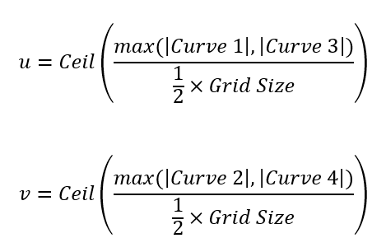
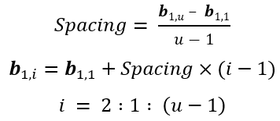
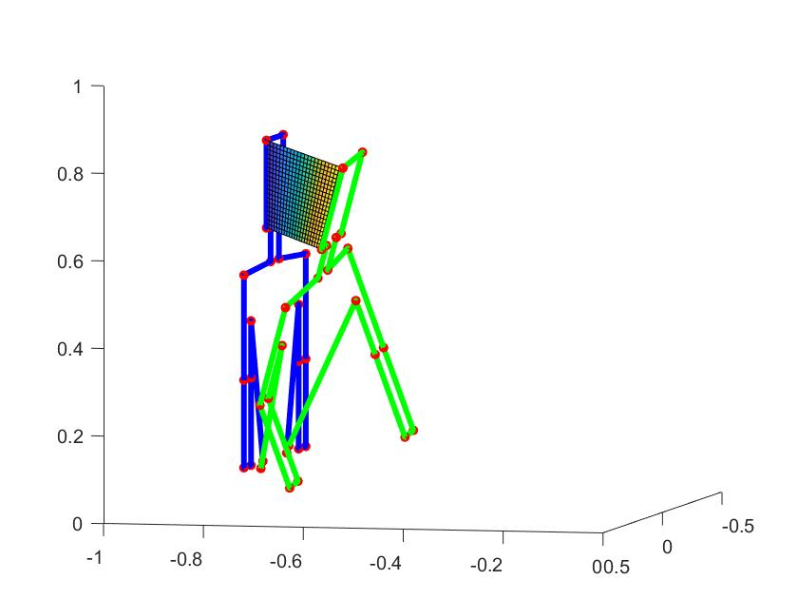



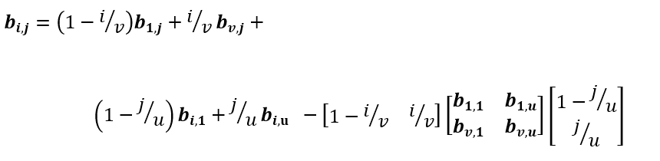

Application of Coons Patches to Fill the Boundary Curves
The mesh of the Coons patch (determining the density of points) is selected based on the grid size on which the objects are modeled
u and v represents the number of points along the horizontal and vertical dimension of the patch respectively
The boundary curves are fully defined by linearly interpolated u and v points between the two boundary points at either end of the boundary curve
Finally, using the discrete Coons patch equation, all interior points on each patch are defined
Notes:
The mesh of the Coons patch (determining the density of points) is selected based on the grid size on which the objects are modeled
Since many patches are required to create a surface, this mesh is to be selected carefully as it drastically alters the computational time
The original grid size of the discretized grid used for comparison of the modeled swept volumes is leveraged to make this decision
It is desirable to at the mesh of the Patch defines points at a spacing slightly higher than the grid size so that when the points are converted back to the standard grid, a near one to one mapping occurs
Furthermore, it is necessary that the Patch has a higher point density than the discretized grid so that it is ensured that no points in the discrete grid that fall within the patch are left unoccupied
In other words, many to one mapping is safer and less likely to misrepresent the swept volume of the modeled object than one to many mapping
u and v represents the number of points along the horizontal and vertical dimension of the patch respectively
These parameters are selected uniquely for each set of X,Y,Z and time patches.
This must be done because a small segment, like the head, should not have the same mesh as a large segment, like the torso
Also, if the arm happens to be moving fast, and sweeps out a larger volume in a given amount of time than the head does, the mesh should be adjusted accordingly
The u parameter is selected by evaluating the Euclidian norm between the boundary points of Curves 1 and 3. The larger of the two should be used to set the spacing
U is then defined as the length of the larger curve divided into sections that are ½ the size of the grid size. This value is then rounded up
The v parameter is selected by evaluating the Euclidian norm between the boundary points of Curves 2 and 4. The larger of the two should be used to set the spacing
v is then defined as the length of the larger curve divided into sections that are ½ the size of the grid size. This value is then rounded up
The boundary curves are fully defined by linearly interpolated u and v points between the two boundary points at either end of the boundary curve
This linear interpolation is done on curves 1 and 3 for (u-2) points between the boundary points along the horizontal edges of the patch
and on curves 2 and 4 for (v-2) points along the vertical edges of the patch
For the time patch, since curves 2 and 4 each represent one time respectively, only linear interpolation is needed for curves 1 and 3
Finally, using the discrete Coons patch equation, all interior points on each patch are defined
With the boundary curves for each patch fully defined in each dimension, the Coons patch equation is iterated for each interior point
to define it according to the horizontal and vertical values of each edge with respect to the distance between the evaluated point and the edges
As well as the values of the four corners with respect to the distance between the evaluated point and the corners

Slide 12
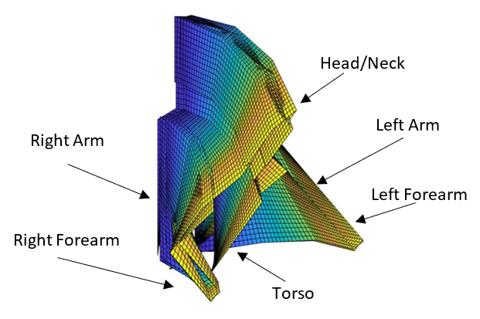
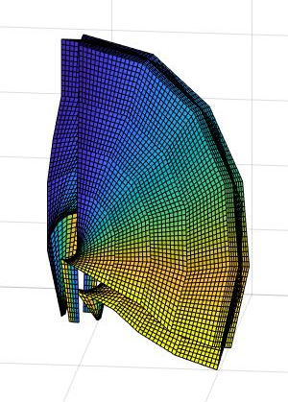
Result From Iteration of Coons Patches
X, Y, Z and time dimension patches are created for the normal and orthogonal boundary curves
The surfaces created from the normal and orthogonal boundary curves are overlaid to fully represent the motion
This algorithm is applied to both the human and the robot
Boundary conditions are still needed to close the surface
Notes:
X, Y, Z and time dimension patches are created for the normal and orthogonal boundary curves
The figures show the spatiotemporal data. In the figures, the color represents the time at which a point is occupied
In the figures, the darker the color, the earlier the time at which that orientation was occupied
The surfaces created from the normal and orthogonal boundary curves are overlaid to fully represent the motion
This algorithm is applied to both the human and the robot
- The algorithm is designed in a generally enough way that it can take an input of an arbitrarily shaped boundary curve at multiple instants in time and piece together the swept surface of the boundary curve
Boundary conditions are still needed to close the surface
- This approach works well for capturing the motion, but leaves gaps in the surface at the initial and final orientation

Slide 13
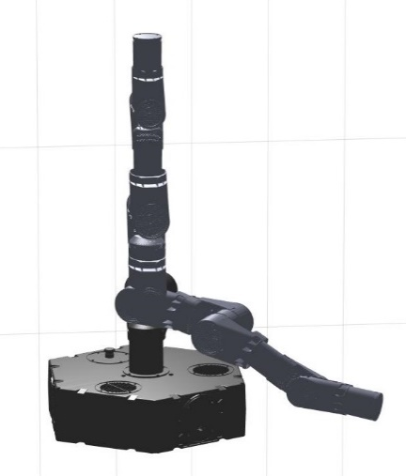
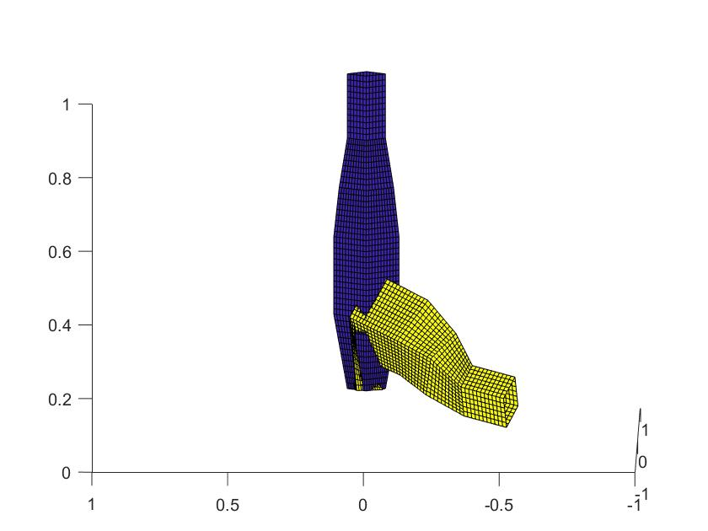
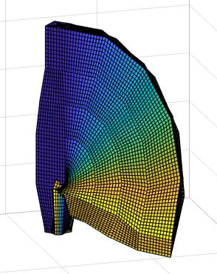
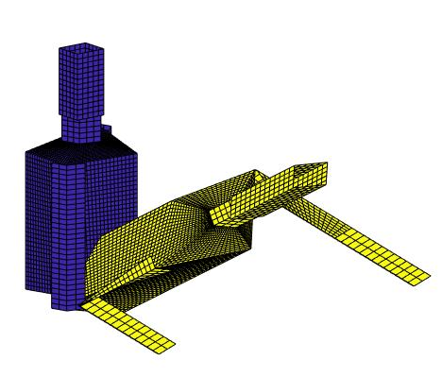
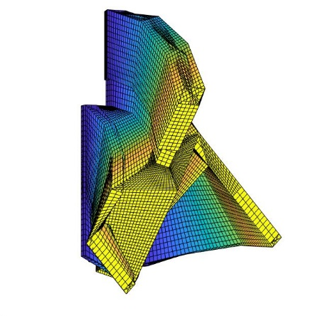
Setting Initial and Final Conditions
The Coons patch portion of the algorithm is reimplemented to wrap a surface around the initial and final conditions
The resulting surfaces are overlaid with the surfaces previously generated
The surface is now closed, representing a swept volume
These surfaces can finally be overlaid and compared for collision
Notes:
The Coons patch portion of the algorithm is reimplemented to wrap a surface around the initial and final conditions
While the same algorithm is used, this implementation of the algorithm takes a bit more thought as it must be determined which points connect to each other
For the initial and final conditions, the points defining the normal boundary curve are connected to the points defining the orthogonal boundary curve
The resulting surfaces are overlaid with the surfaces previously generated
The surface is now closed, representing a swept volume
These surfaces can finally be overlaid and compared for collision

Slide 14
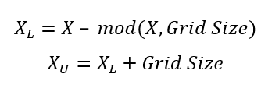

Collision Check: Standardized Grid
Both surfaces are converted back to the standardized grid for direct comparison
Each spatial dimension (X,Y,Z) is cast into an array
Taking advantage of the known grid spacing, an upper and lower bound for each point is defined
The point is then set equal to whatever bound it is closest to
This is completed for the time dimension by adopting a discrete standardized timeline
Notes:
Both surfaces are converted back to the standardized grid for direct comparison
This is necessary as the patches for either volume are not defined in a standard system but at unique points in space and time according to the result of the linear interpolation and Coons patch equation
By converting everything to a standardized grid, values between the two volumes that are close to each other before the collision will now exactly match each other
Each spatial dimension (X,Y,Z) is cast into an array
For the set of equations to the left, this sample calculation will be carried out for the X dimension, but applies to the Y, Z, and time dimension as well
X is the array of X values in the patch formed by concatenating each row of the patch. Each patch is placed into this array
The order of the placement is noted and reused for each other dimensions so that each set of X Y Z and time points can be matched up
Taking advantage of the known grid spacing, an upper and lower bound for each point is defined
The lower bound is set by subtracting from the actual value the remainder of the quotient of the actual value and the grid size
The upper bound is simply found by adding the grid size to the lower bound
The point is then set equal to whatever bound it is closest to
- This is done in 2 steps:
- First, a binary array, $X_{binary}$ is constructed by placing a 1 at all index values for which the distance between $X_{u}$ and X is less than the distance between $X_{L}$ and X
if X is closer to the upper bound, a 1 will be returned. All other positions are set to zero
Second, the closest bound is selected by setting X equal to the element by element sum of $X_{L}$ and the product of the binary array and the grid size.
Thus, for all positions where X is closer to the upper bound, one increment of the grid size will be added to the lower bound.
This is completed for the time dimension by adopting a discrete standardized timeline

Slide 15
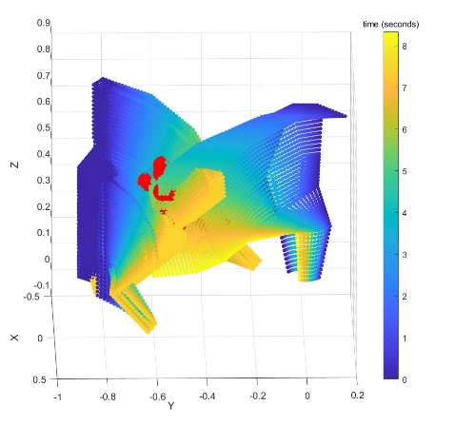
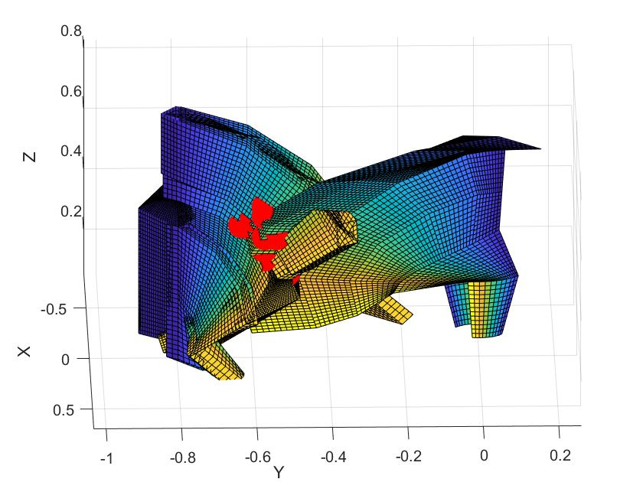
Collision Check: Evaluation of Spatio-Temporal Intersection
Finally, the volumes can be directly compared
Anywhere the data exhibits spatio-temporal intersection, a collision has been identified from the predicted input data
Notes:
Finally, the volumes can be directly compared
The algorithm compares the standardized X,Y,Z, and time data from each swept volume
Anywhere the data exhibits spatio-temporal intersection, a collision has been identified from the predicted input data
For the example in the figure, collision points are noted in red

Slide 16
Timed Testing
For all testing, randomized joint trajectories were used each iteration of the test
Computational efficiency for a range of grid sizes was tested
Plotted results indicate an exponential increase in computation as grid sizes decreases
For grid sizes greater than 0.07 m, the algorithm runs in real time (less than 30 ms).
Notes:
For all testing, randomized joint trajectories were used each iteration of the test
Each joint was assigned a random starting and ending
Computational efficiency for a range of grid sizes was tested
At each grid size the algorithm was run and timed 100 times. The run time for these 100 tests was averaged and plotted against the corresponding grid size
Plotted results indicate an exponential increase in computation as grid sizes decreases
Computational time blew up for grid sizes below 0.02 m.
The second plot to the left shows in greater resolution the computational time of the algorithm at grid sizes of 0.05 m through 0.15 m
For grid sizes greater than 0.07 m, the algorithm runs in real time (less than 30 ms).

Slide 17
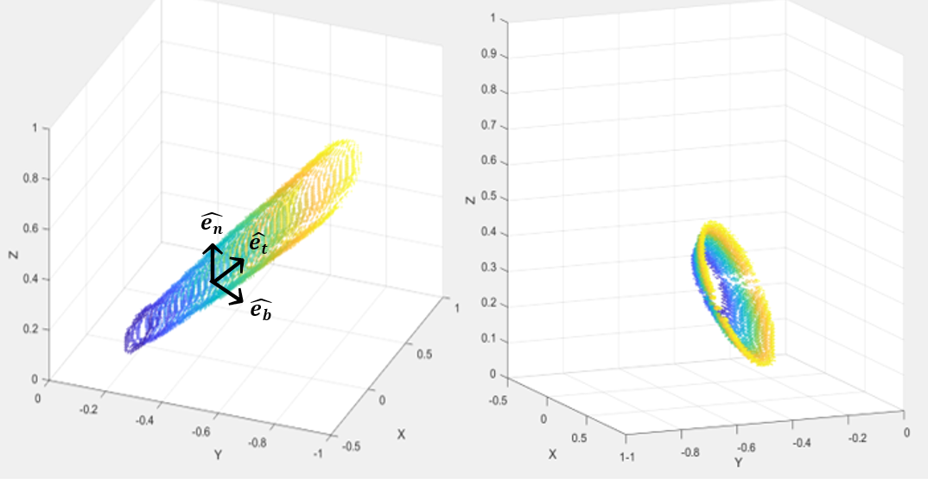
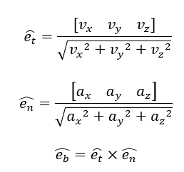
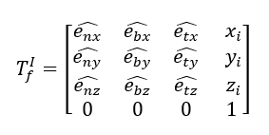
Modeling Different Types of Obstacles
In addition to the modeling technique used for articulated objects, another technique was tried
A swept ellipse was modeled along a trajectory
Timed tests on this approach indicated an expected run time of 62.3 ms
If an obstacle like this is desired, it is suggested that Coons patches be implemented to increase computational efficiency
Notes:
In addition to the modeling technique used for articulated objects, another technique was tried
A swept ellipse was modeled along a trajectory
Definition of the boundary of the ellipse at each instance along the trajectory was done in a plane orthogonal to the direction of motion
At each step, an intrinsic coordinate is established, and the ellipse is drawn in the normal-binormal plane
The coordinates of the ellipse are then translated from the intrinsic coordinate system to the fixed system
Timed tests on this approach indicated an expected run time of 62.3 ms
100 timed runs of the generation of just the obstacle were averaged to yield this test time.
This was for a trajectory that spanned the distance across the workspace
Given that the time to generate this swept obstacle alone was twice that of the run time for generation of the articulated model at grid spacings greater than 0.07 m, and since the articulated model represented a much larger and more complex obstacle, the work was developed around the articulated model.
The advantage of the articulated obstacle is that it implements Coons patches to reduce computation. It is expected that models similar to the one pictured to the left can be constructed at a much lower computational cost by defining boundary curves and using Coons patches.

Slide 18
Effectiveness Testing
Effectiveness was defined as the ability of the algorithm to consistently identify if a collision occurred or not
For this test, one scenario was tested at 15 different grid sizes
This test was carried out for 100 randomly generated tests
Results:
- 87 tests maintained the solution across all grid sizes
- 5 tests converged to a consistent solution
- 4 tests were unable to converge to a consistent solution
Notes:
Effectiveness was defined as the ability of the algorithm to consistently identify if a collision occurred or not
It is assumed that at smaller grid sizes are more accurate
Thus, the primary goal of this test was to see how consistently a collision was identified or not at all grid size
A secondary goal for when not all grid sizes yielded the same result was to see if the algorithm still converged to a solution as the grid size decreased
For this test, one scenario was tested at 15 different grid sizes
As done before, the scenario was randomly generated
Failure of the algorithm occurred when the algorithm could not converge to a single prediction
This test was carried out for 100 randomly generated tests
Results:
- 87 tests maintained the solution across all grid sizes
- 5 tests converged to a consistent solution
- 4 tests were unable to converge to a consistent solution
For the 9 tests in which the algorithm didn’t maintain the same prediction across all grid sizes, the highest resolution at which the algorithm misidentified a collision was at 0.060 m, while
the average grid size at which the algorithm converged was 0.110 m.
The 4 tests that were unable to converge to a consistent solution were each evaluated.
These cases each represented situations in which both volumes came nearly indistinguishable close. So much so that it was difficult to identify from the generated figures if an actual collision took place.
To reinforce the algorithm against such cases, two measures have been taken in the design of the algorithm
1) The safety factor is built in to protect the human from these scenarios. This factor exaggerates the modeled human so that the cases where collisions are inconsistently identified occur outside the actual bounds of the human. To increase the effect of the safety factor, the rate of expansion can further be tuned. The algorithm is set up in such a way that this parameter is easy to adjust according to the situation. For situations in which safety is of more concern, such as in the case of human collaborators with low confidence in the robot or operations with high payloads or dangerous tools, this factor can be increased. To validate this claim, one of the fringe cases for which the algorithm had trouble identifying the collision was investigated. This case was rerun with a greater safety factor. It was found that by increasing the safety factor, the algorithm was able to identify collisions at all grid sizes
2) The second design consideration meant to assist with this issues that the algorithm is designed to operate in real time. The algorithm was shown In the timed testing to reliably run in less than 30 ms. If the algorithm misidentifies whether or not a collision occurs, it will have another opportunity to remedy this in a fraction of a second. This drastically increases the chances of the eventually correcting.

Slide 19
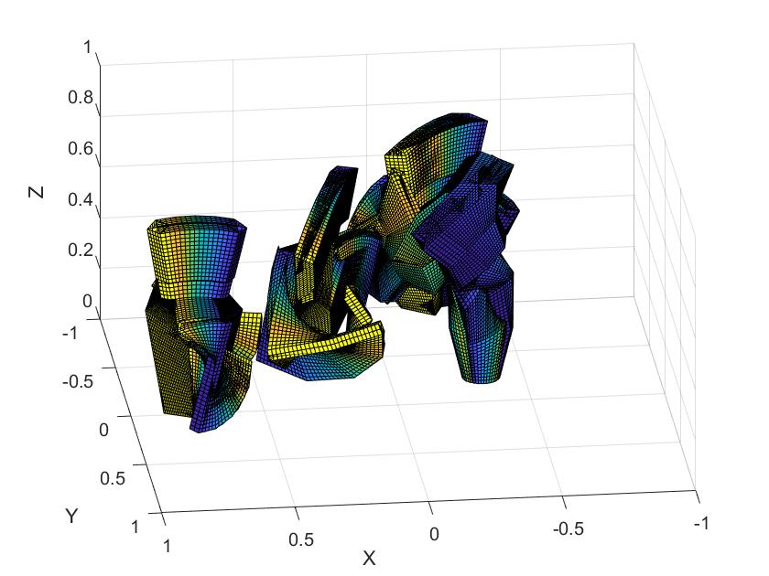
Computational Effect of Collision Detection with Multiple Humans
The computational efficiency of the algorithm was further evaluated as more humans were introduced to the environment
In addition to the data from scenarios with 1 human, scenarios with 2, 3, 4, and 5 humans were tested
The same testing procedure as implemented before was implemented again
Notes:
The computational efficiency of the algorithm was further evaluated as more humans were introduced to the environment
In addition to the data from scenarios with 1 human, tests with 2, 3, 4, and 5 humans were tested
For each subsequent scenario, a human was added at a different location in the environment
The same testing procedure as implemented before was implemented again
Each scenario was tested at each of the 15 grid sizes between 0.01 and 0.15 m 100 times with randomly generated joint trajectories

Slide 20
Computational Effect of Collision Detection with Multiple Humans
The algorithm’s average run time for each scenario is plotted versus the corresponding grid size
Results show a nearly proportional increase in computational time with the addition of more humans to the environment
A diminishing proportion as humans are added can be explained by overhead costs of running the algorithm and modeling of the robot
While the algorithm can handle additional humans in the environment without blowing up, doing so causes the algorithm to not run in real time
Notes:
The algorithm’s average run time for each scenario is plotted versus the corresponding grid size
The second plot shows in greater resolution the computational time of the algorithm at courser grid sizes for each scenario
Results show a nearly proportional increase in computational time with the addition of more humans to the environment
In scenario one, corresponding to two humans in the environment, after doubling the number of humans modeled in the environment, the computational time increases by only a factor of roughly 1.5.
In scenario two, corresponding to three humans in the environment, after tripling the number of humans modeled in the environment, the computational time increases by a factor of roughly 2.
For scenarios three and four, corresponding to four and five humans in the environment this factor becomes approximately 2.5 and 3.
A diminishing proportion as humans are added can be explained by overhead costs of running the algorithm and modeling of the robot
With the addition of each human, only a portion, albeit a large portion, of the algorithm is repeated
The computational cost of modeling the robot and other components of the algorithm remain the same regardless of the scenario
These fixed costs are mitigated amongst the variable costs, resulting in a reduction in the increase of the computational time with respect to the increase of humans modeled
While the algorithm can handle additional humans in the environment without blowing up, doing so causes the algorithm to not run in real time
One interpretation of this result is that the algorithm can be used for monitoring larger environments and taking measures to adapt the robots path far in advance, but as humans get close enough to interact with the robot, and the robot needs to respond in real time, attention should be focused on only the closest humans.

Slide 21
Conclusion
Contribution: a quick, effective predictive collision detection algorithm
Novelty: The approach used Coons patches to interpolate between sampled orientations of a body throughout time
Application: Use in a suite of robot control techniques for Human robot Collaboration
Future Works:
Adaptations of the algorithm’s initial steps based on variation in input data
Evaluation of optimal number of poses used to construct the sweep
Optimization of the grid size based on input data
Notes:
Contribution: a quick, effective predictive collision detection algorithm
designed to run in real time as a background operation of a robot controller
Novelty: The approach used Coons patches to interpolate between sampled orientations of a body throughout time
This allowed for continuous collision detection at a low computational cost
The approach effectively strikes a balance between the robustness of swept surface methods and the computational efficiency of multiple detection interference methods
Application: Use in a suite of robot control techniques for Human robot Collaboration
The algorithm is specifically developed as a contribution to a collaborative efforts between multiple universities, corporate sponsors, and research labs
Its function will be to operate as a watchdog algorithm to look ahead at its trajectory the evolving environment and preemptively predict collisions
This algorithm will then trigger a path adaptation algorithm that will leverage a priori known trajectory information along with the spatio temporal information developed in this algorithm to adapt its actions and reactions optimally
Future Works:
Adaptations of the algorithm’s initial steps based on variation in input data
Our collaborators are still in the process of developing their predictions for the human. While the robot trajectories wont change, the format of the data for the human predictions can still change.
If this happens, either a conversion must take place to put that data into the current format of the input data, or the initial forward kinematics section of the algorithm will need to adapt.
Evaluation of optimal number of poses used to construct the sweep
Since the Coons patches represent linear interpolations between the poses, the approximation is less accurate for trajectories that display a high degree of curvature.
If this begins to cause issues, a subject for future study will be to develop a quick preliminary evaluation of the input joint angles to determine the degree of curvature.
The purpose of this algorithm will be to quantify the number of poses from the input data needed to accurately describe the surface.
Optimization of the grid size based on input data
The goal of this work would be to understand the required grid size based on the complexity and size of the object to be modeled

Slide 22
Acknowledgements
Funding was provided by University of Florida’s Scholars Program.
Research conducted in support of NSF/NRI: INT: COLLAB: Manufacturing USA: Intelligent Human-Robot Collaboration for Smart Factory (Award I.D. #:1830383).
Any opinions, findings and conclusions or recommendations expressed are those of the researchers and do not necessarily reflect the views of the National Science Foundation.

